Slide 1
INTRODUCTION TO SCREEN PRINTING

Slide 2
Screen printing is pretty simple:
First, you stretch silk or a similar fabric over a frame.
Then, you use something to block out any area you don’t want to get ink (or stay the color of the paper or fabric).
Then you scrap ink over the surface with a squeegee and the ink appears on any area that has not been blocked.

Slide 3
Screen printing is a fairly new printing technique. It was originally invented to print patterns on fabrics.

Slide 4
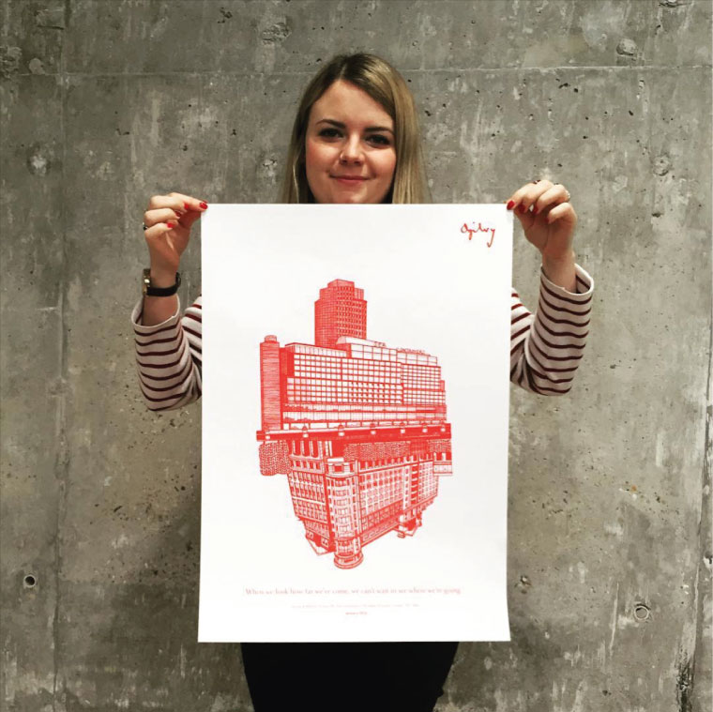
Then, artists got hold of it and started making some pretty awesome stuff.

Slide 5
After that artists got tricky and started making multiple screens to do more than one color.

Slide 6
They also figured out how to use photosensitive chemicals to create a stencil from a photograph.

Slide 7
Screen printing is everywhere, on posters…

Slide 8
cards, invitations, etc.

Slide 9
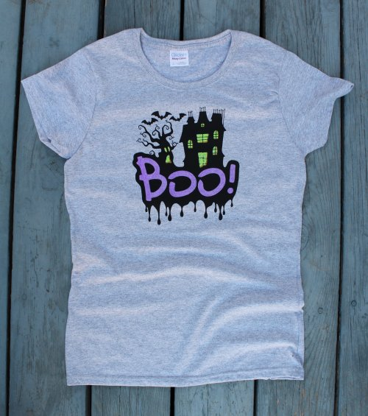
…and almost all t-shirts are done using the screen printing process.

Slide 10
For your first screen printing assignment you will be designing a t-shirt graphic.
First pick a group of people that you want to design a t-shirt for (your family, a club, your school, your favorite sports team, etc.) OR a holiday/occation t-shirt
Brainstorm ORIGINAL images you could use to represent your group (you cannot use logos that already exist and must be school appropriate). Remember the images should be complex enough that they are interesting if you are just using one color but simple enough you could do them as a screen print.
Draw out 3 or 4 thumbnail sketches as possible designs.
Pick your best design and draw it to size (about 9x9 inches). REMEMBER ANY WRITING MUST BE MIRROR IMAGED!
Build your screen using an embroidery hoop.
Trace your design onto your screen with a felt tip pen.
Paint any area you don’t want ink with sealing polymer.

Slide 11
Here are some examples:

Slide 13
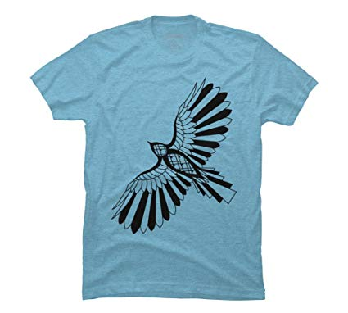

Slide 17
