Slide 1
Lucy Truman
APSTUDIO ART PORTFOLIO

Slide 2
WRITTEN EVIDENCE:
At first, the question I wanted to explore was 'how does motion show character?' That was pretty broad so I narrowed it down to 'what do we value?' and then since my pieces were all going the same direction with that, I decided to make it even more specific and my theme was 'what is knowledge?' The first three projects I focused on the idea of finding knowledge or wisdom, then the next few showed how

Slide 3
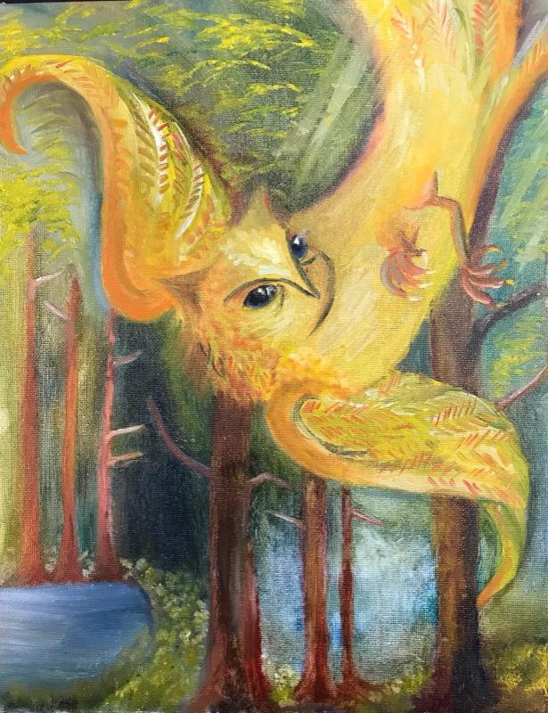

Slide 4
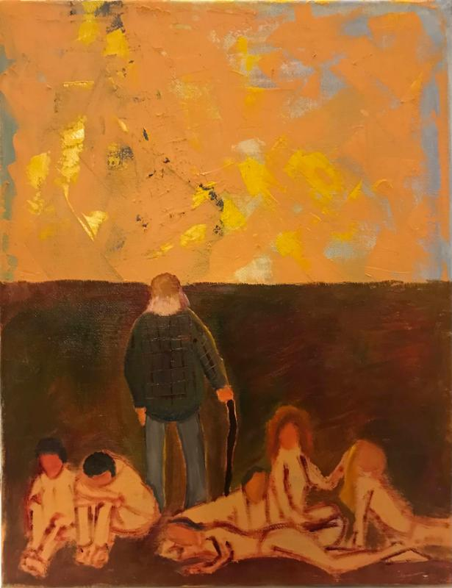

Slide 5
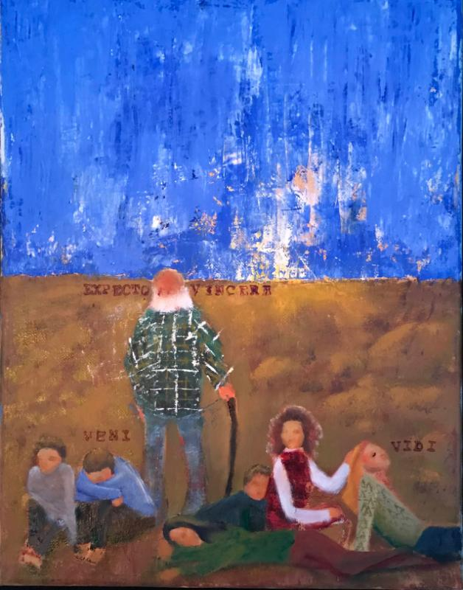

Slide 6
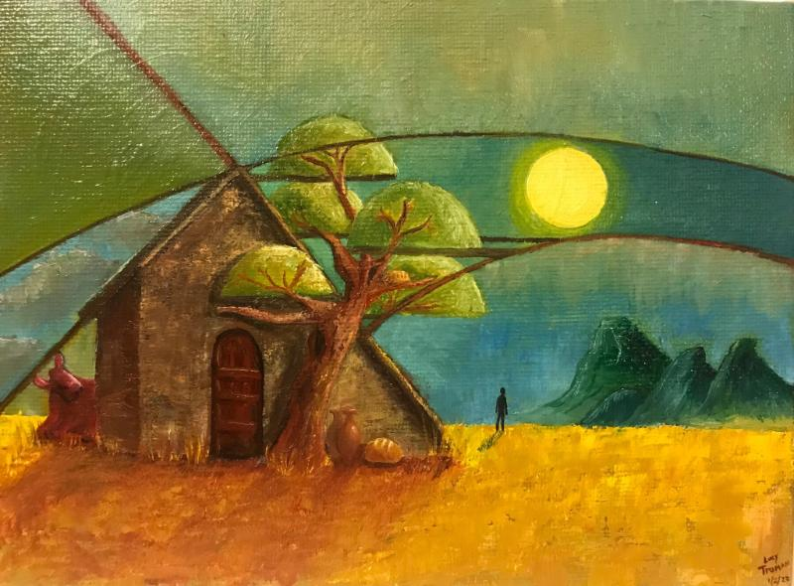

Slide 7
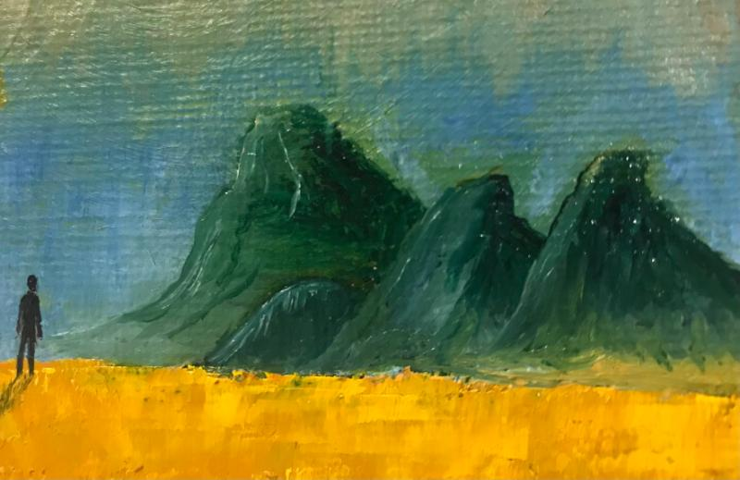

Slide 8
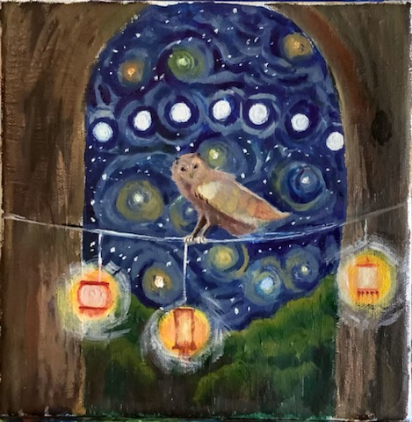

Slide 9
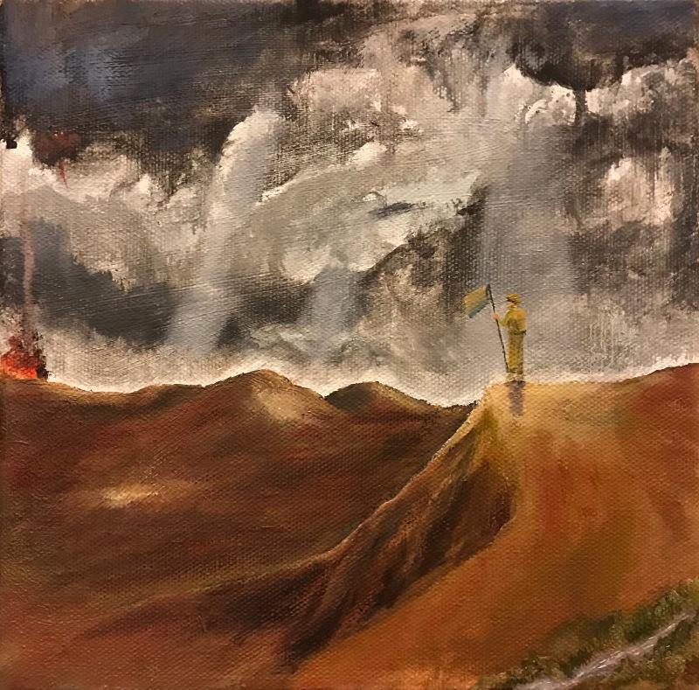

Slide 10
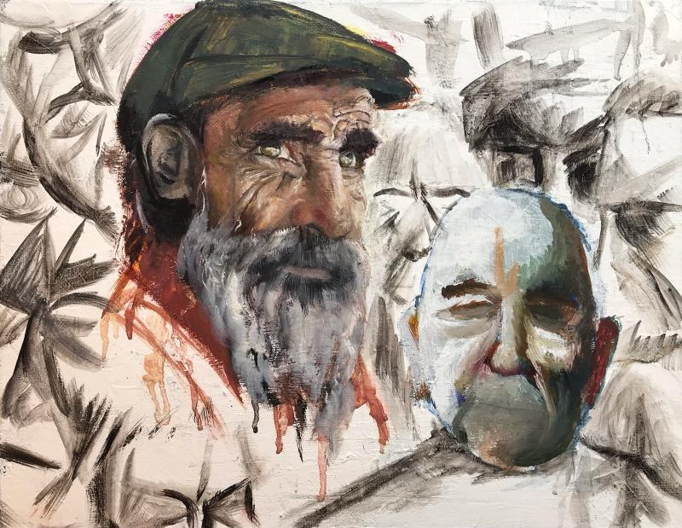

Slide 11
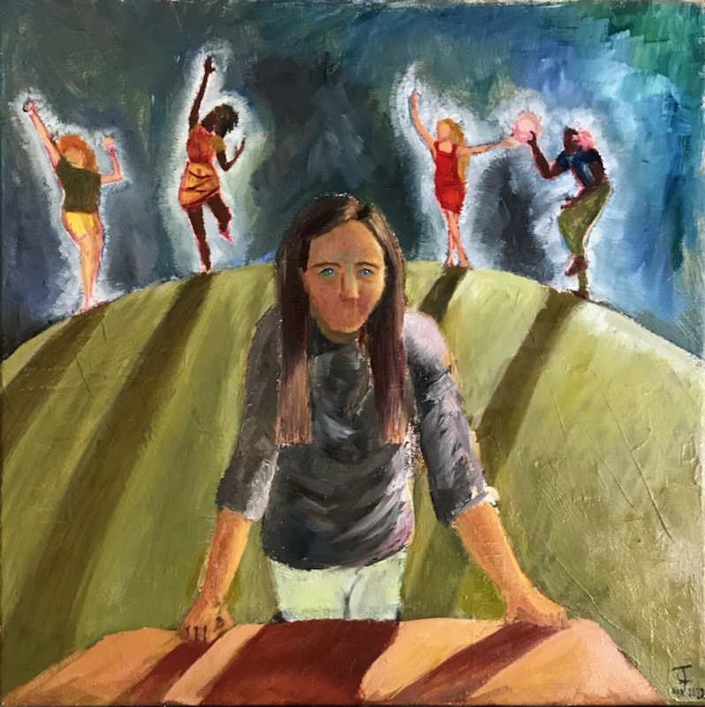

Slide 13
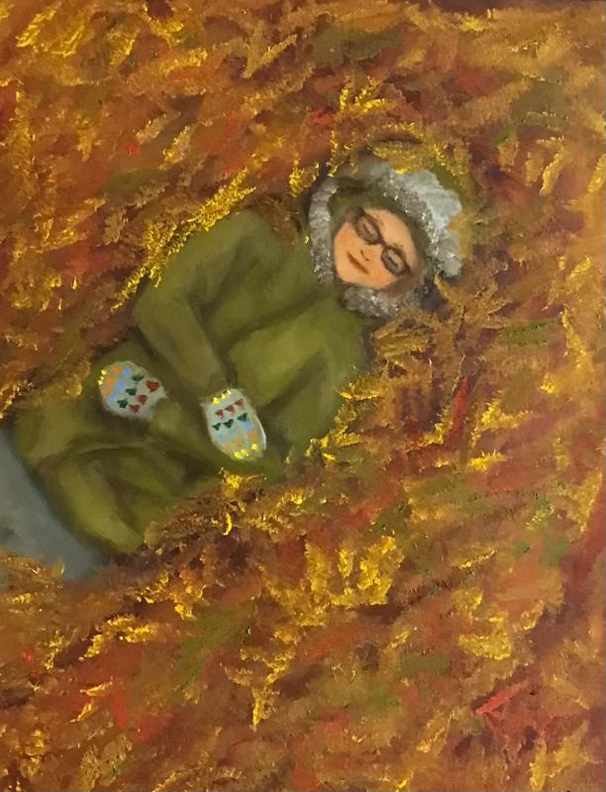

Slide 14
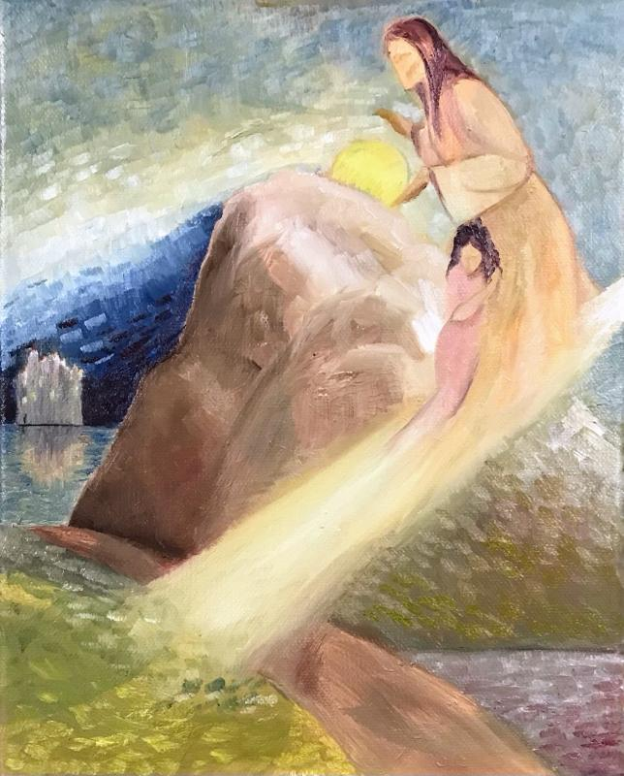

Slide 15
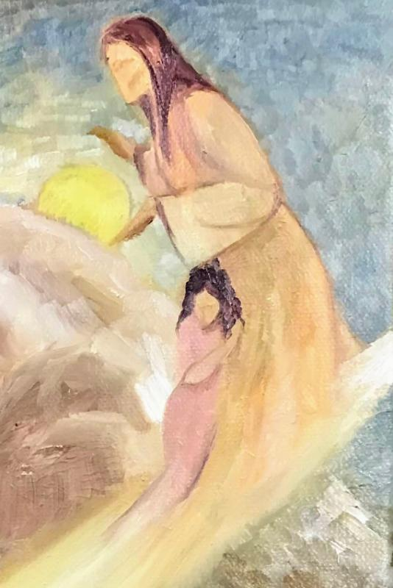

Slide 16
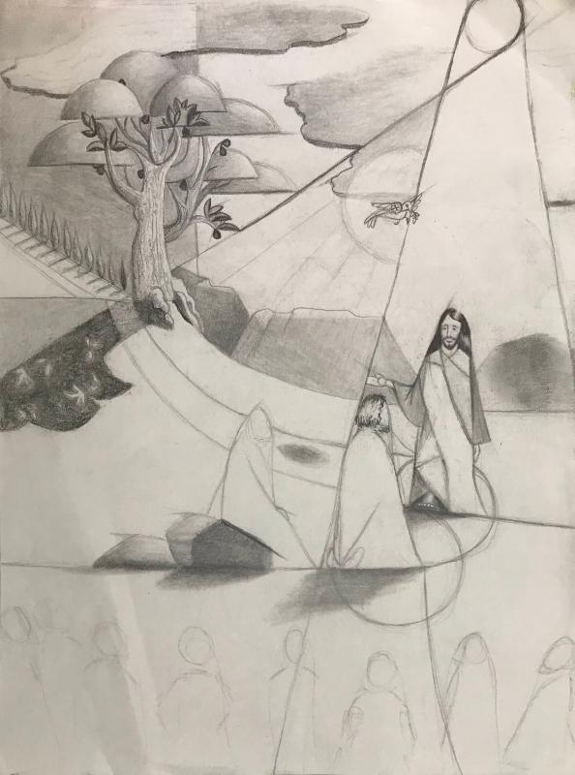

Slide 17
