Slide 1
CREATING AN CHILDHOOD MEMORY CARDBOARD RELIEF SCULPTURE

Slide 2
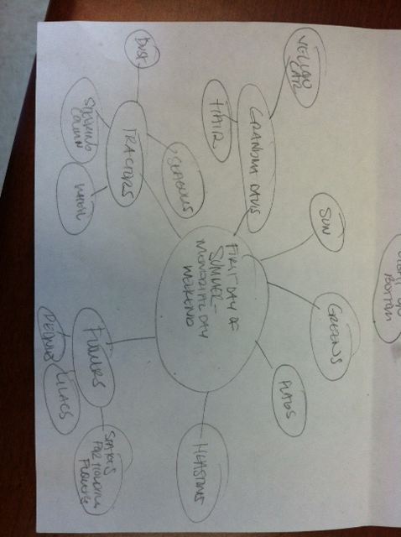
For this project you will start by brainstorming a memory.

Slide 3
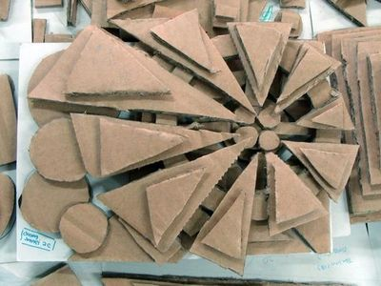
Think of shapes & symbols that would represent your memory.

Slide 4
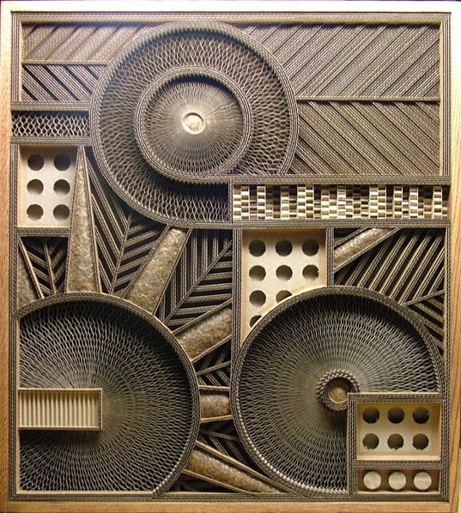
You can be very abstract.

Slide 5
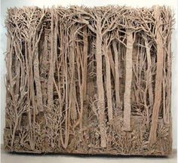
Or a more realistic. Remember these are NOT trying to be a photographic representation of actual things – they are a symbol images from your memory.

Slide 6
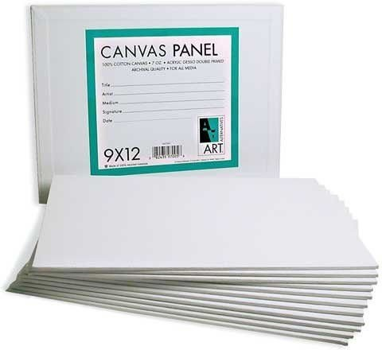
You will start with a 9 x 12 inch canvas board.

Slide 7
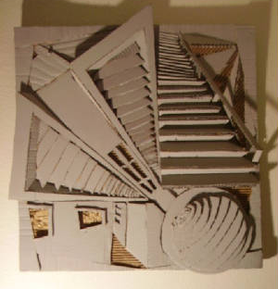
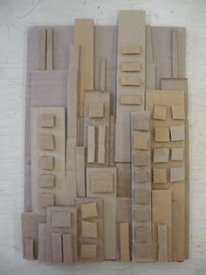
Then you can build up your “relief sculpture” by adding layers of cardboard shapes, etc.

Slide 8
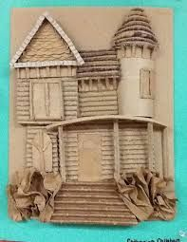
You can layer your paper or cardboard to add depth.

Slide 9
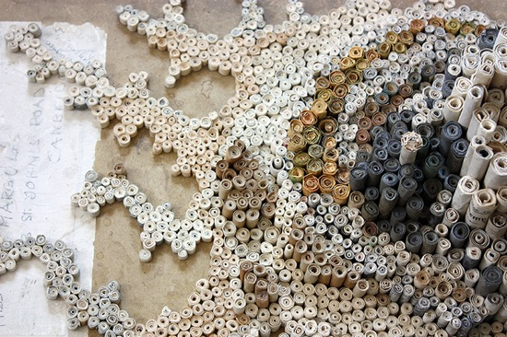
Rolled paper can also add interest and texture.

Slide 10
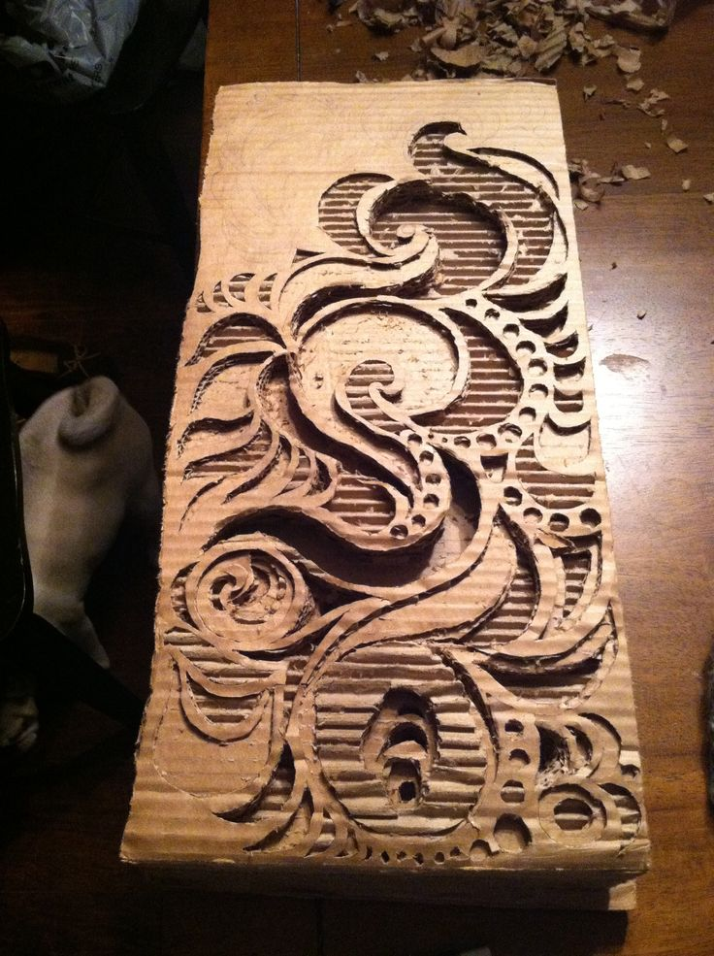
Or cut out some design elements.

Slide 11
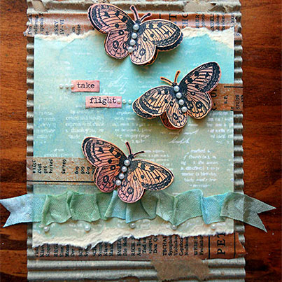
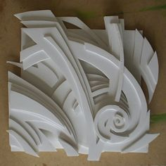
You can add other elements too. Like, collage, yarn, buttons, etc. Be creative and think outside the box.

Slide 12
Then, we will paint them with a primer (gesso).

Slide 13
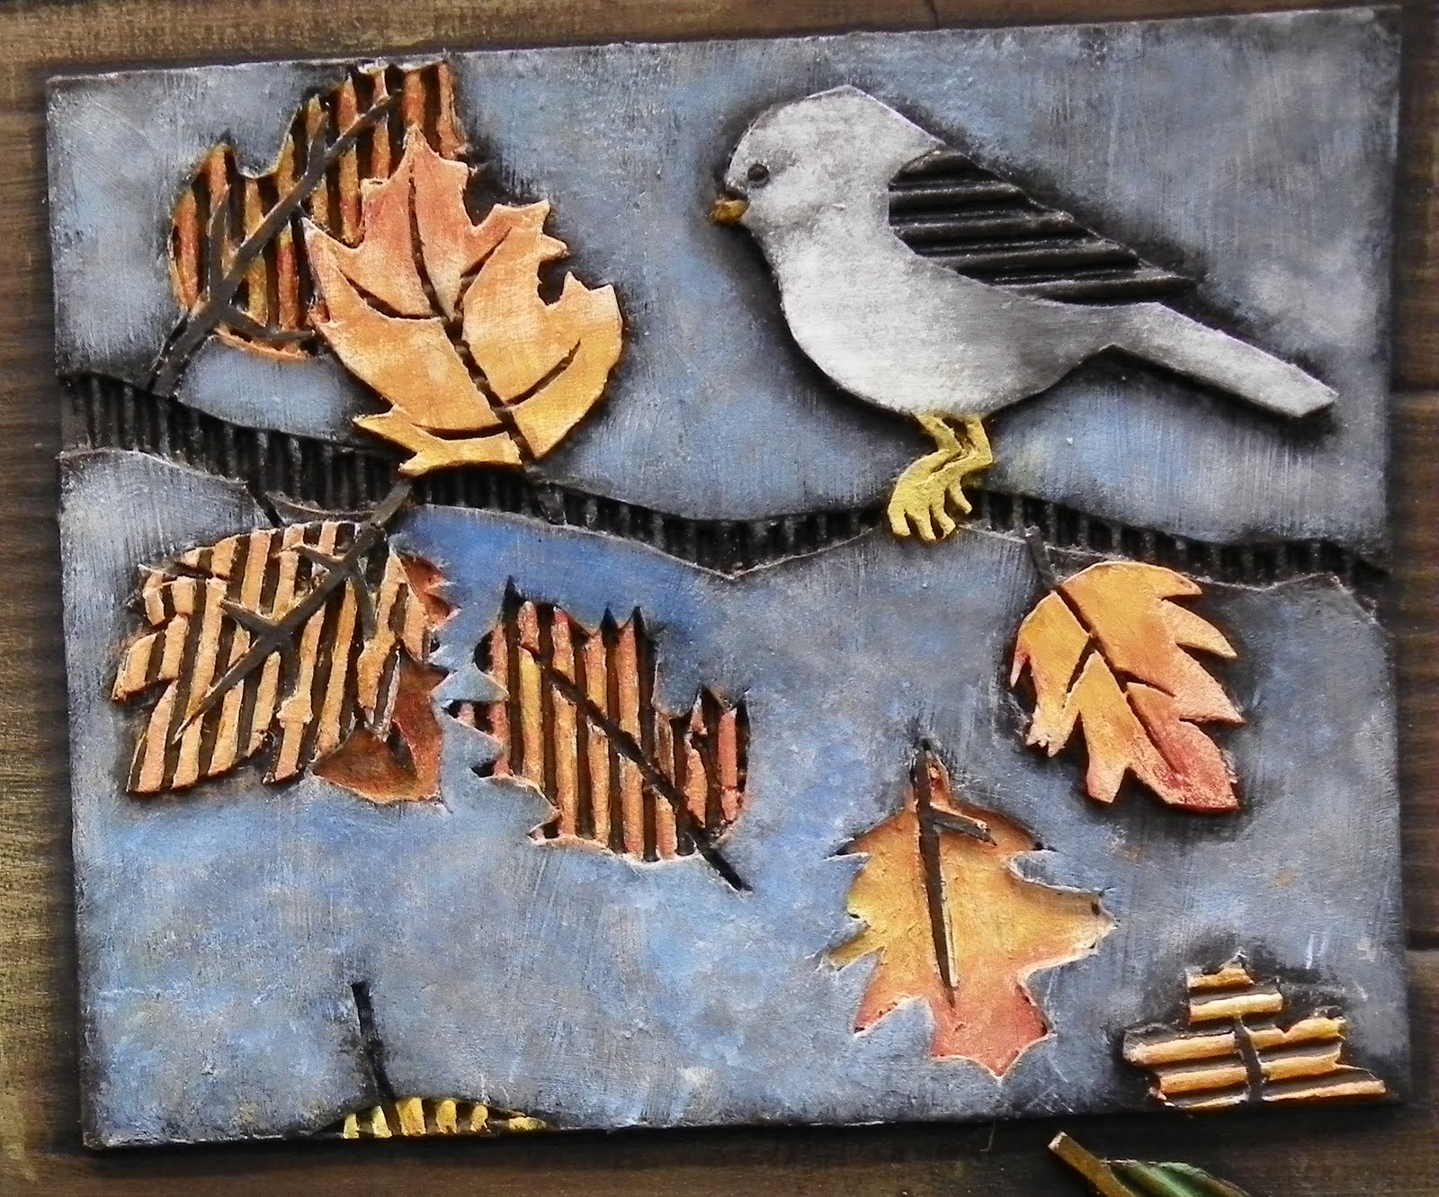
And then paint or finish them.

Slide 14
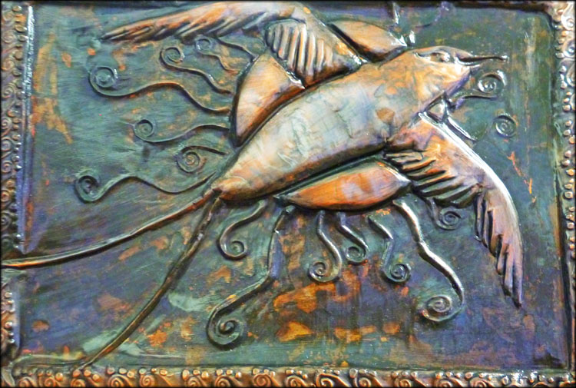
Here’s some examples:

Slide 15
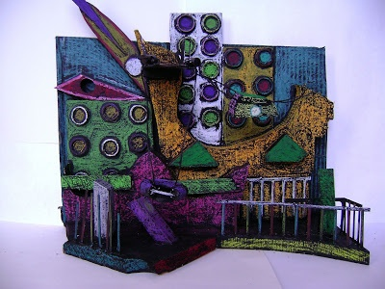

Slide 16
