Slide 1
10 Reasons Why I love Painting (and teaching it)
By the end of this class I hope you will love it too!

Slide 2
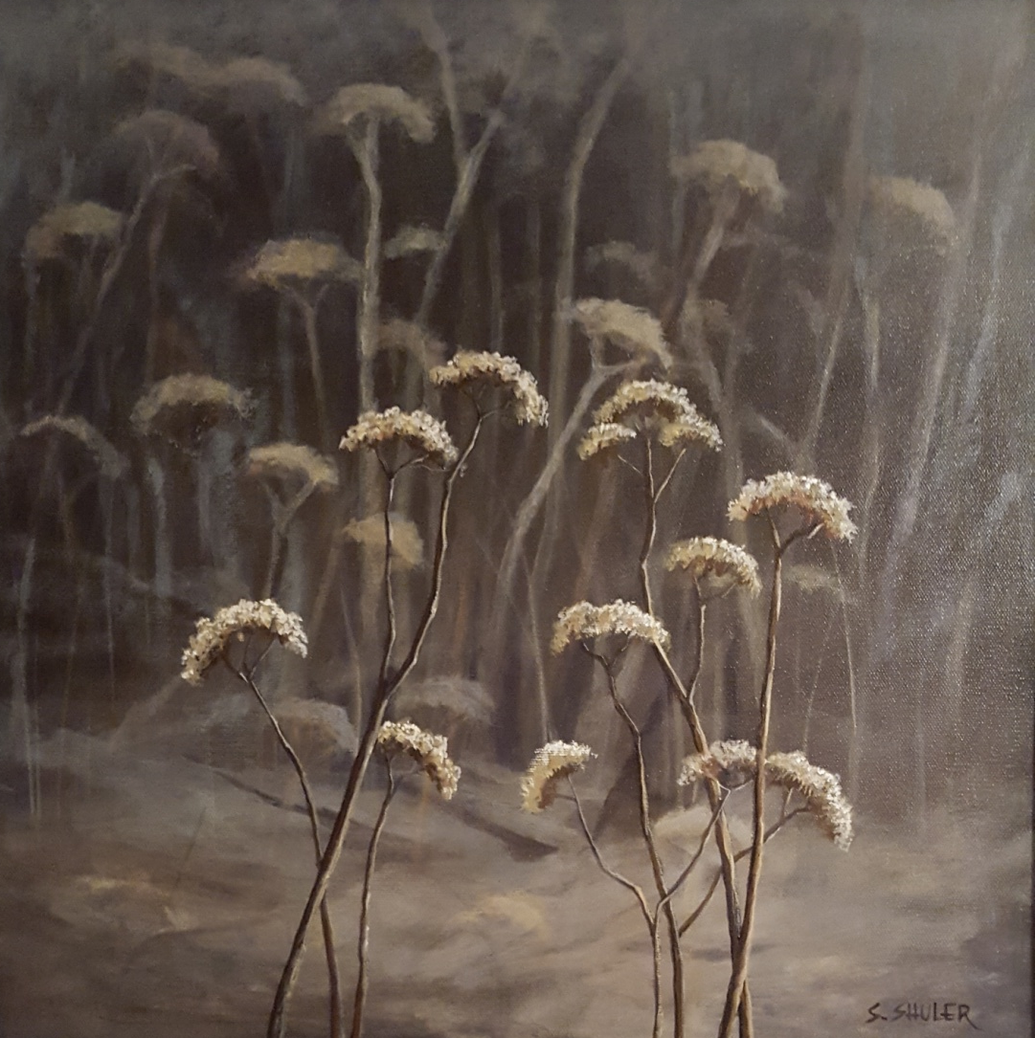
1. Painters see things other people miss!

Slide 3
2. Artists get paid to play!
https://www.youtube.com/watch?v=r7gWljt49G4

Slide 4
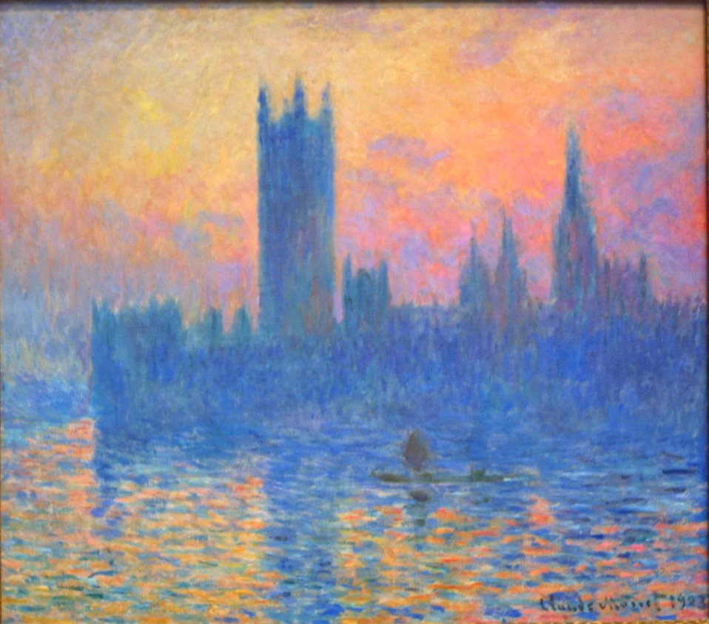
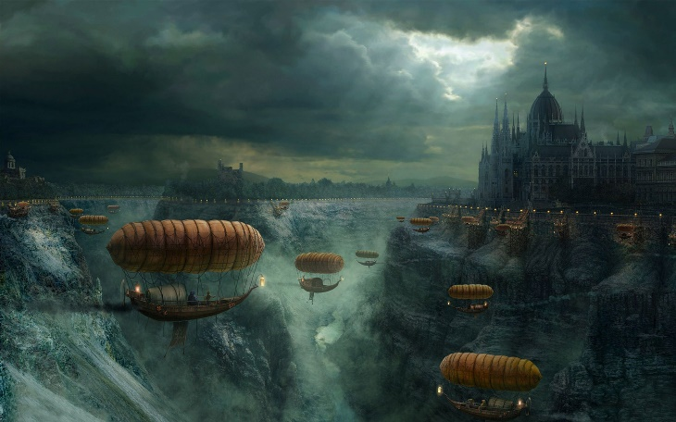
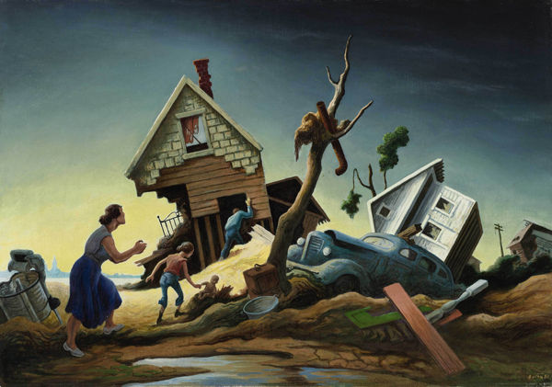
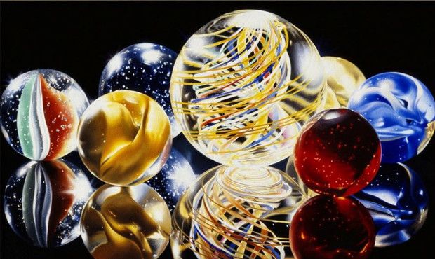
3. There are so many types and styles of painting almost everyone can find something they enjoy!
Sculpture
Painting
Photography

Slide 5
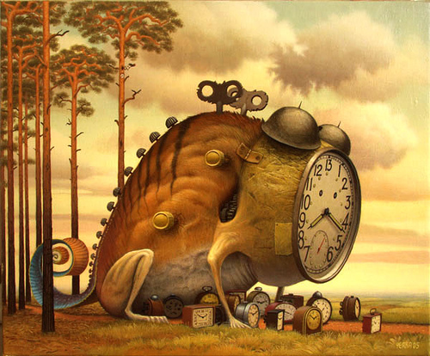

Slide 6
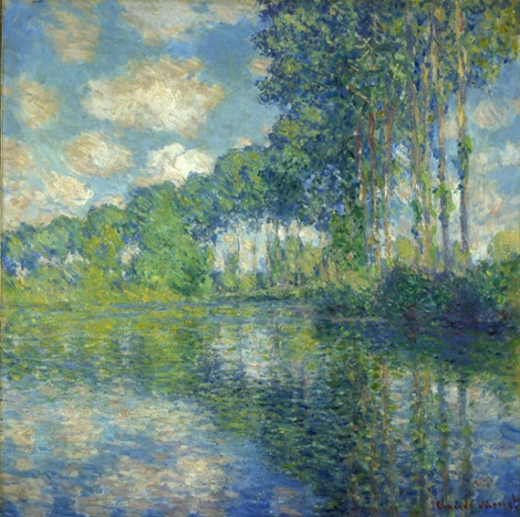
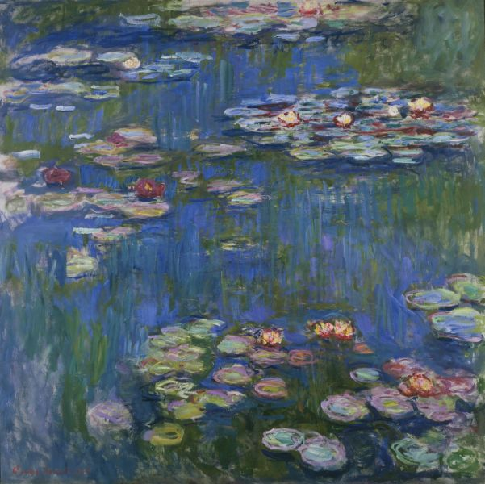

Slide 7
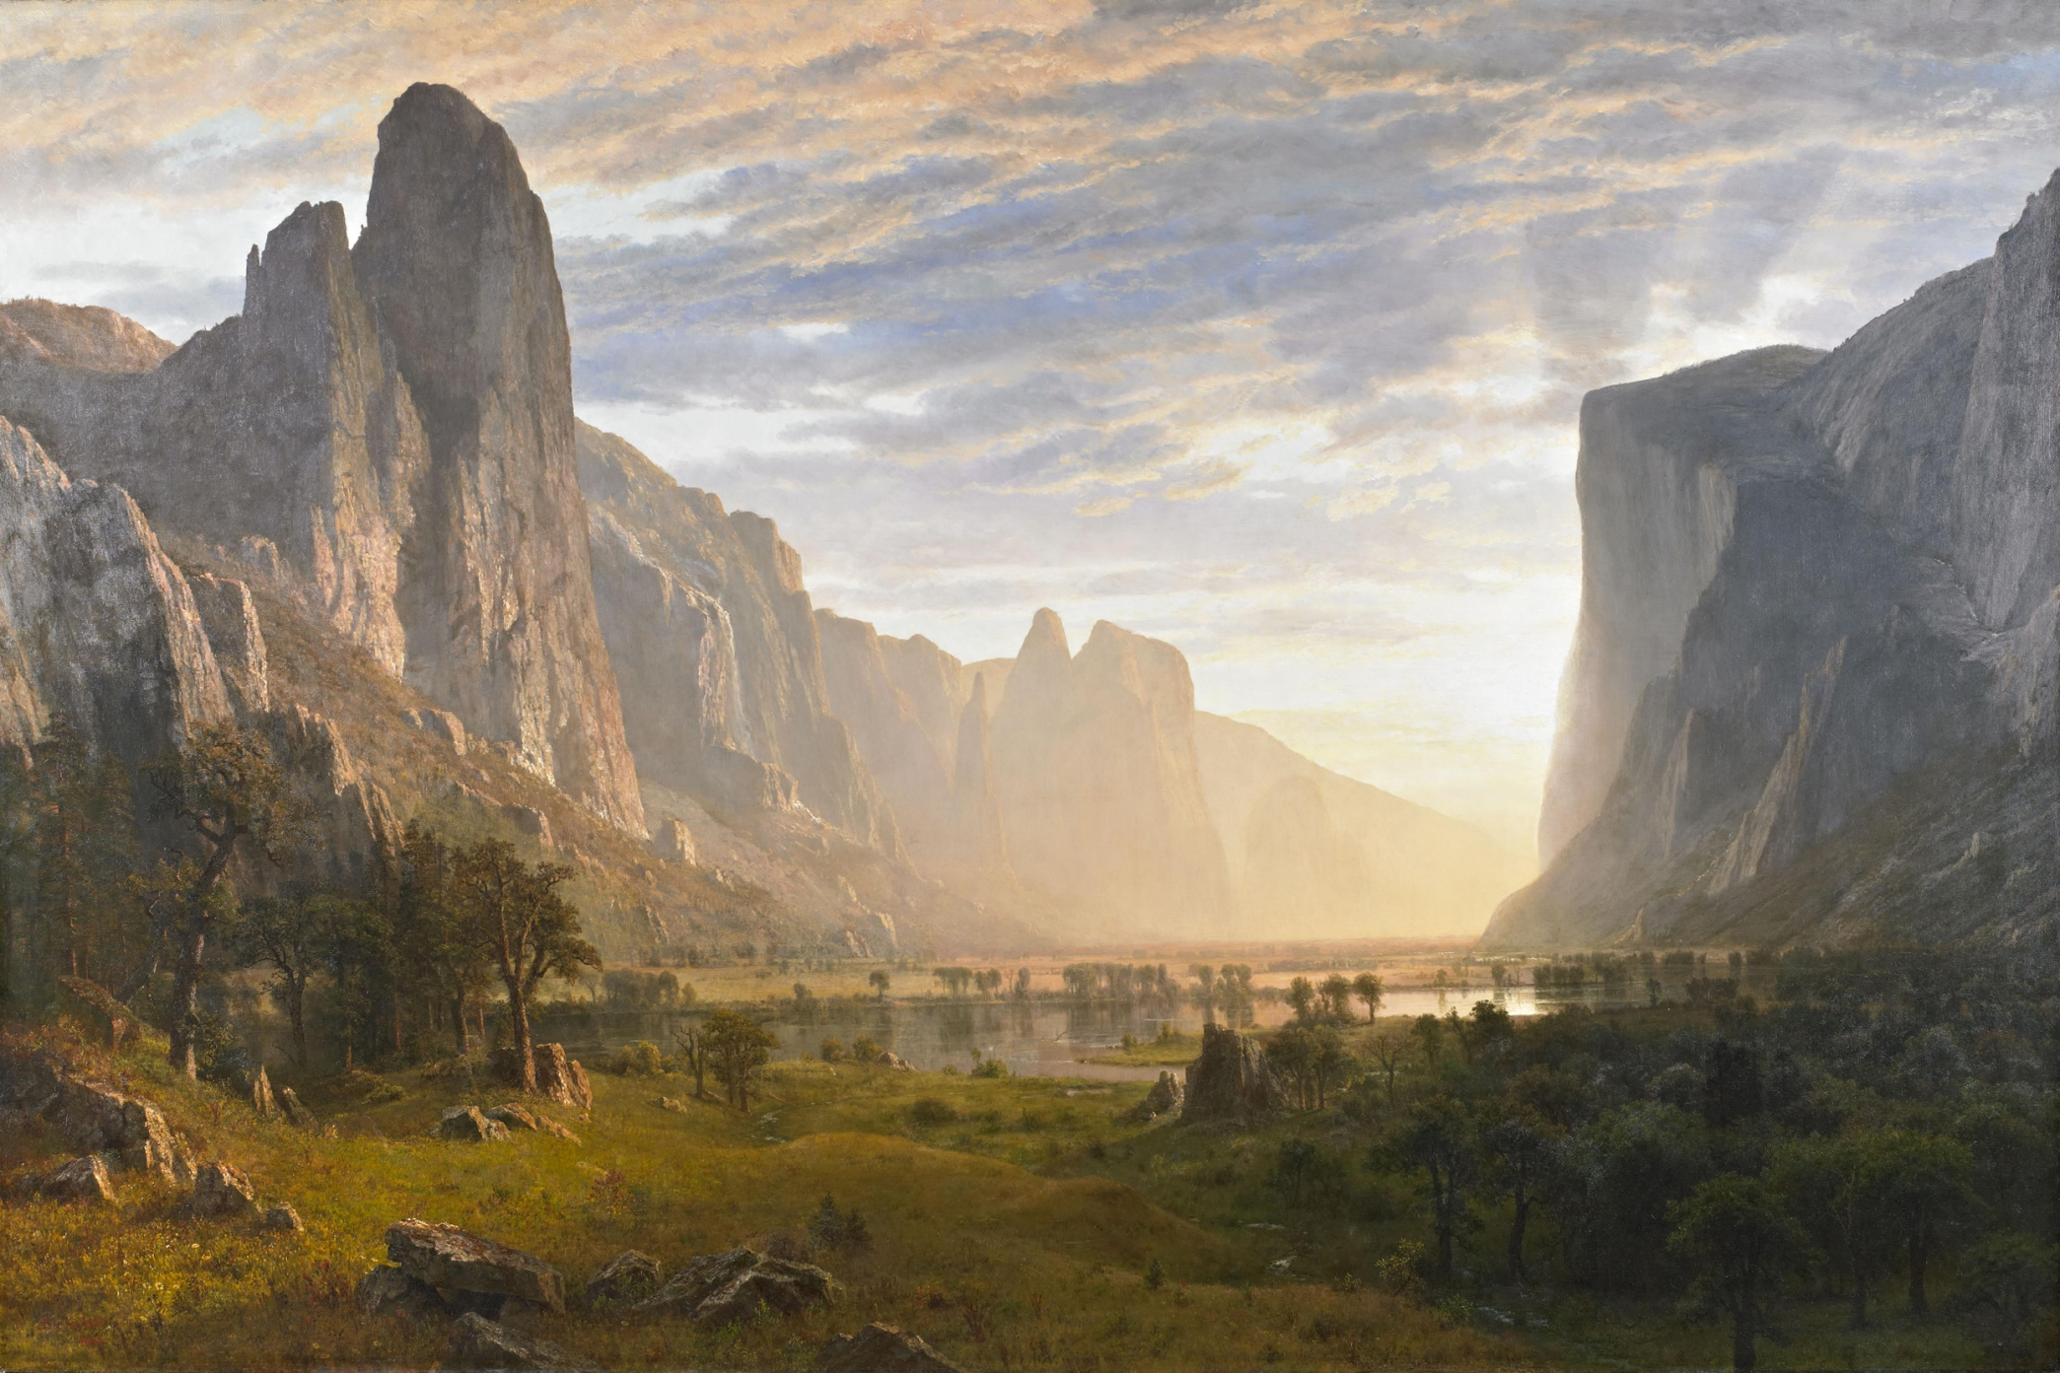

Slide 8
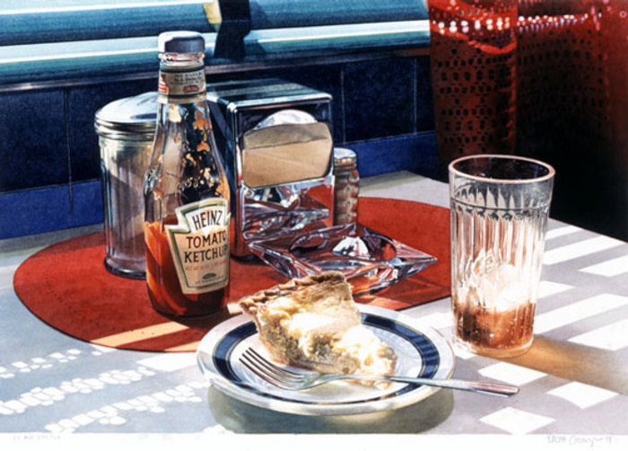

Slide 9
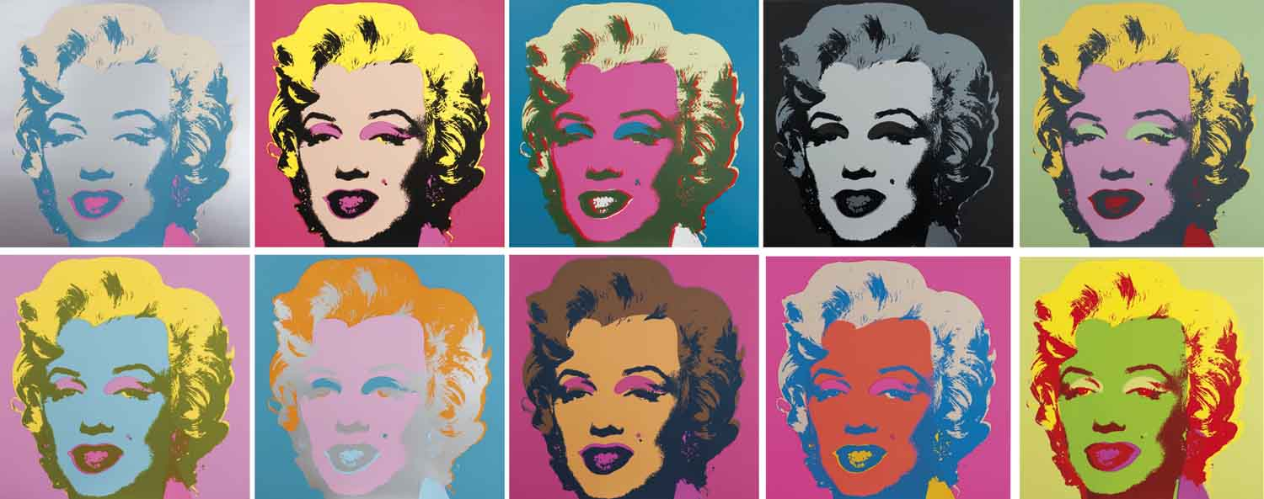

Slide 10
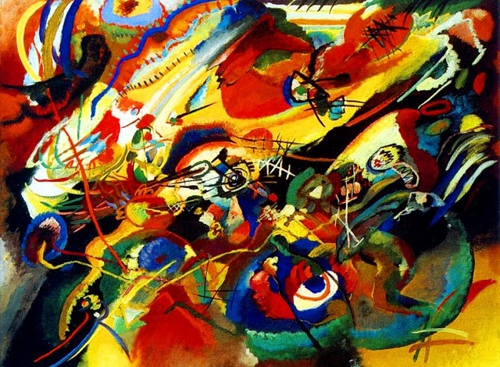
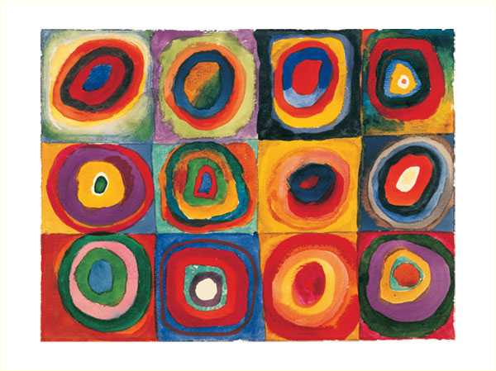

Slide 11
4. It’s great to do when you are bored!

Slide 12
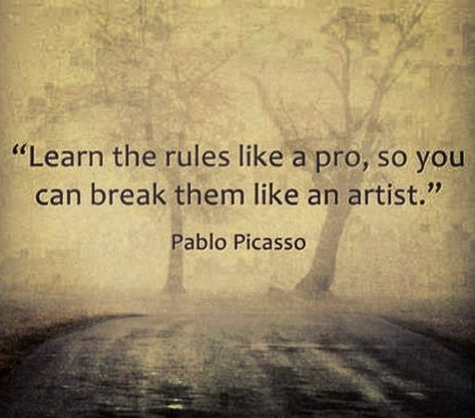
5. You can break the rules!

Slide 13
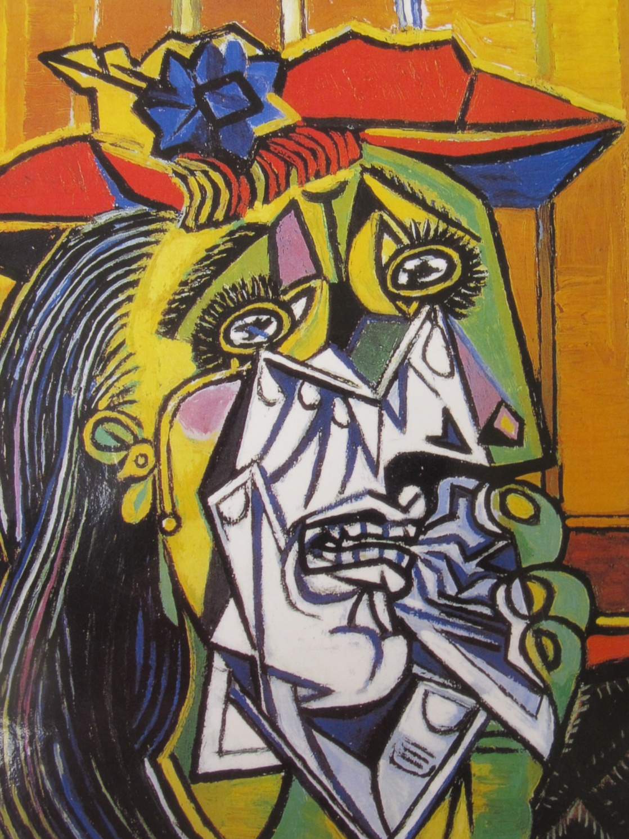

Slide 14
6. It’s fun!
https://www.youtube.com/watch?v=d6egUsZvWu4

Slide 15
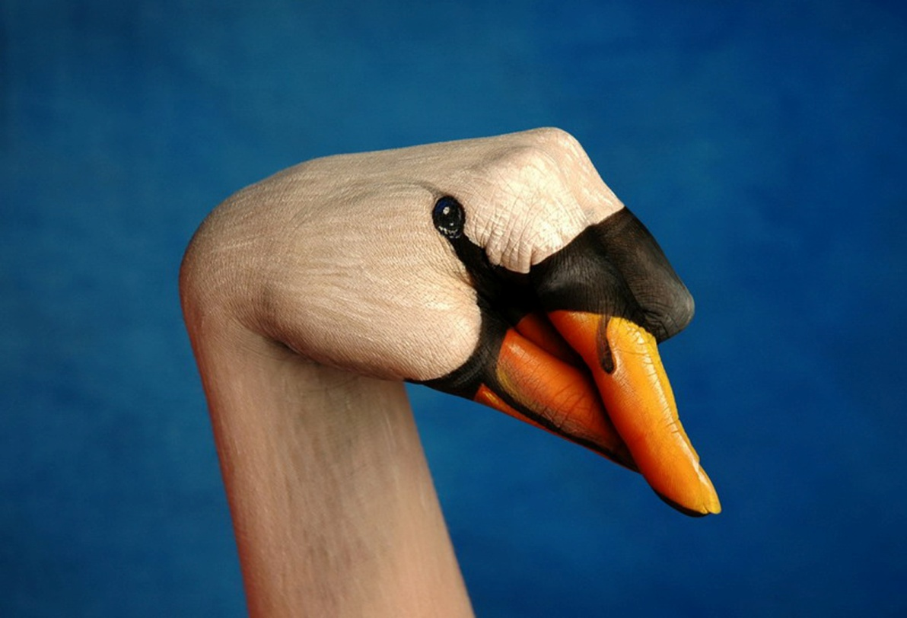
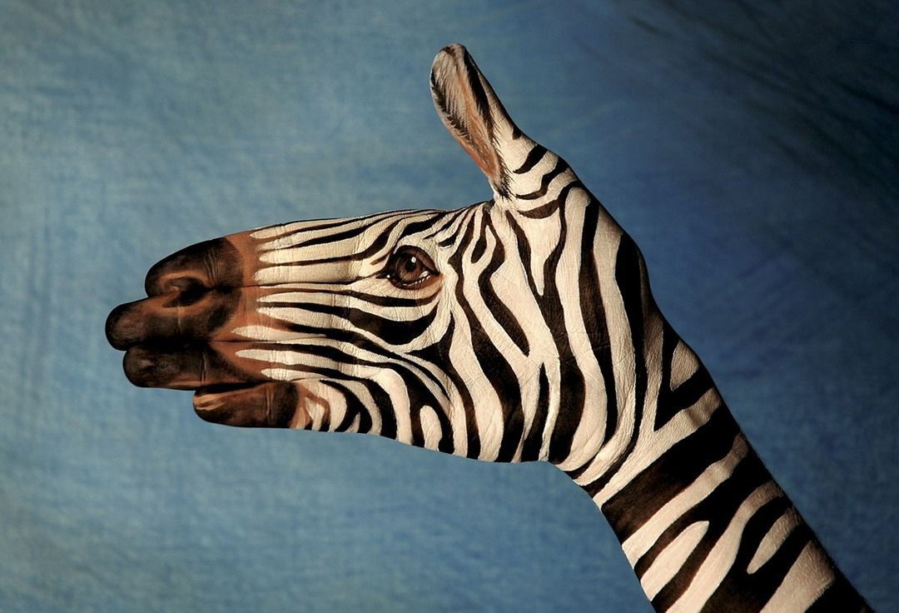

Slide 16
7. You can express what you are feeling and thinking.

Slide 17
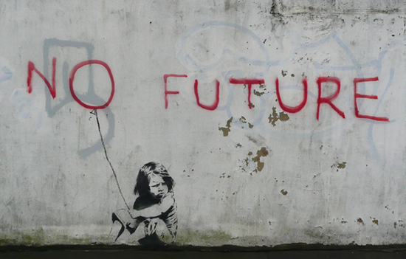

Slide 18
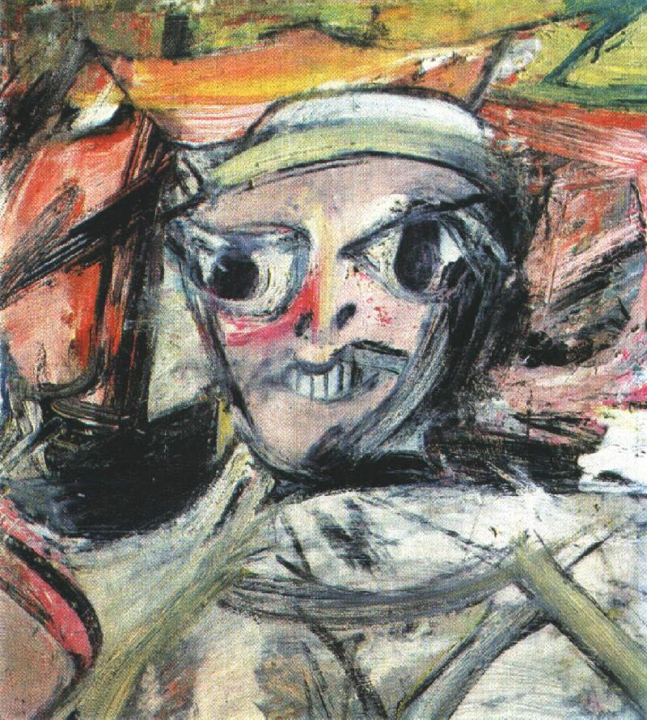
8. If your art looks terrible you can just say: “it’s modern art – you wouldn’t understand.”
“Woman” by Wilhelm de Kooning

Slide 19
9. Its cheaper than a psychiatrist!

Slide 20
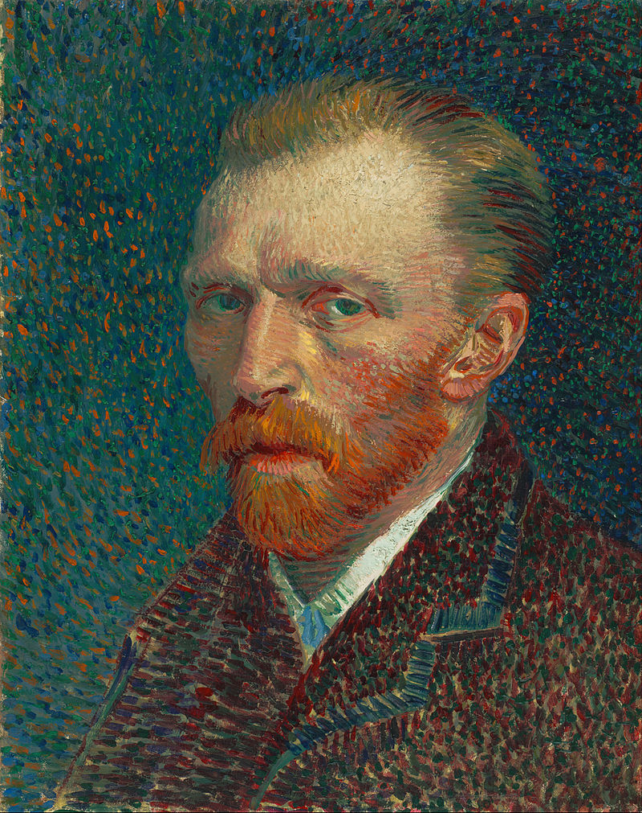
10. Artists are amazing and interesting people.
Vincent Van Gogh kept painting in spite of mental illness and very little success. In fact, he painted over 900 paintings and 1,100 drawings and only sold one in his life time. Now that is persistence.

Slide 21
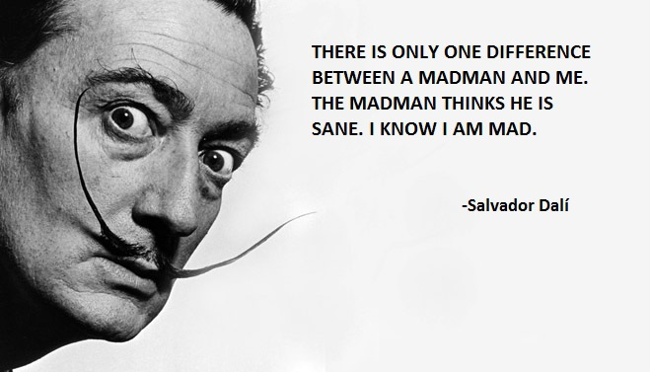
Salvador Dali was famous for his unusual obsessions, phobias and unusual behavior. He was terrified of grasshoppers (he never walked on grass). He had a fear of exposing his feet, so he never went shoe shopping. He was convinced someone was trying to poison him, so he hired someone to taste his food before he would eat anything. Once he drove around in a white Rolls-Royce filled to the roof with cauliflower.

Slide 22
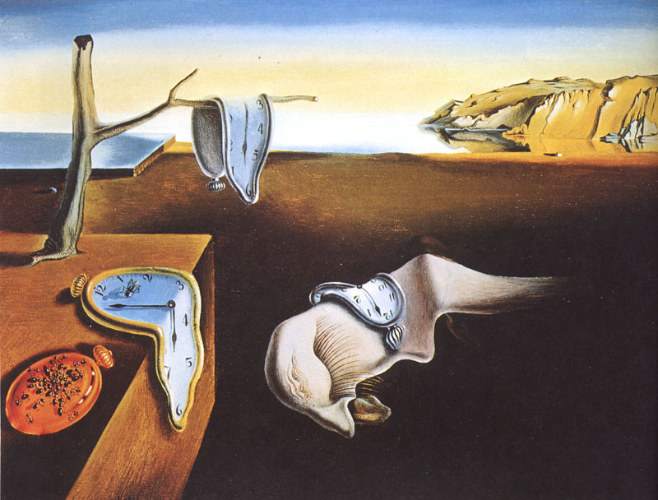
But he created some amazing and interesting paintings.

Slide 23
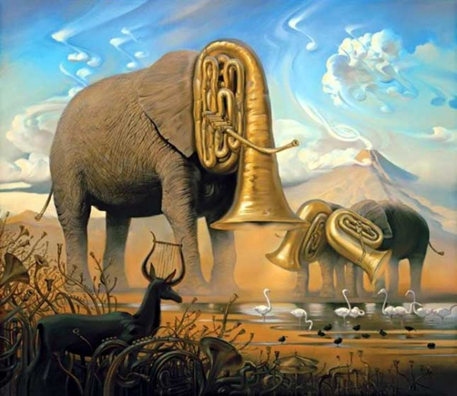
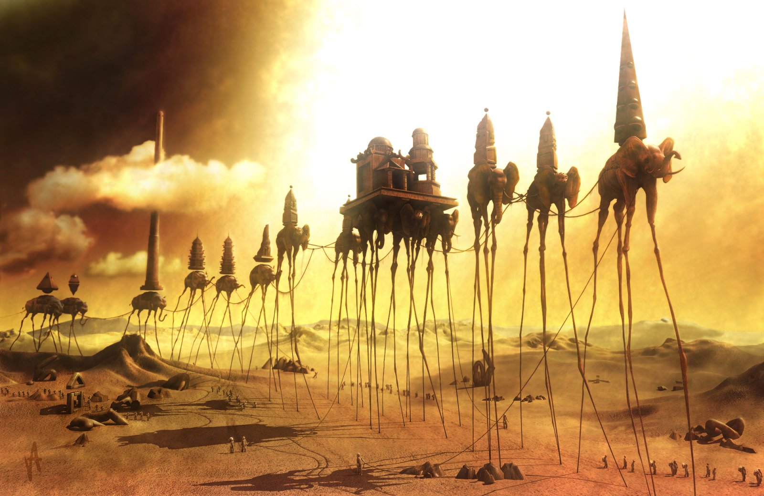

Slide 24
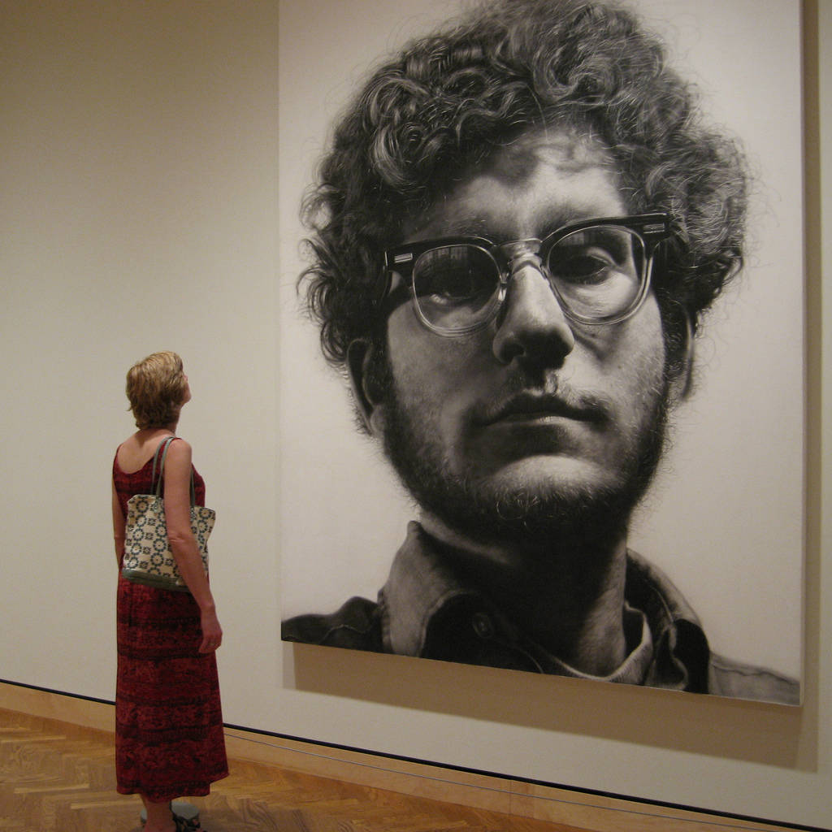
Chuck Close was a famous realist painter when he had a rare spinal cord collapse and lost the use of his arms and legs. The doctors said, “You’ll never paint again.” He told his doctors, “that is not an option.” He then developed a whole new way to paint in a whole new style.
BEFORE

Slide 25
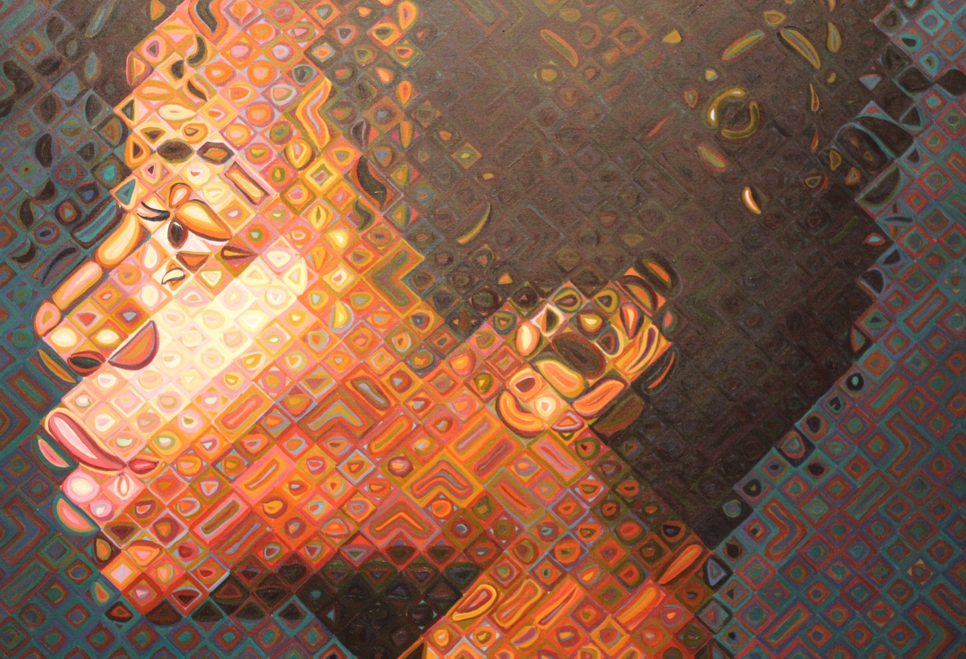
NEW STYLE!

Slide 26
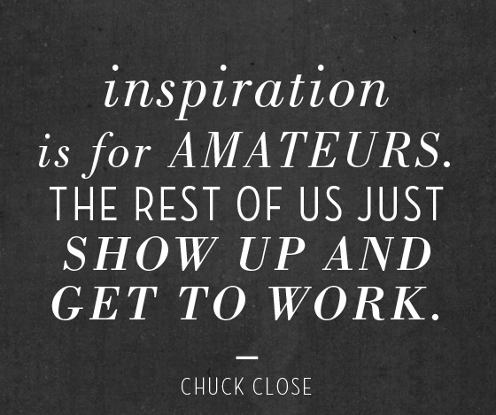
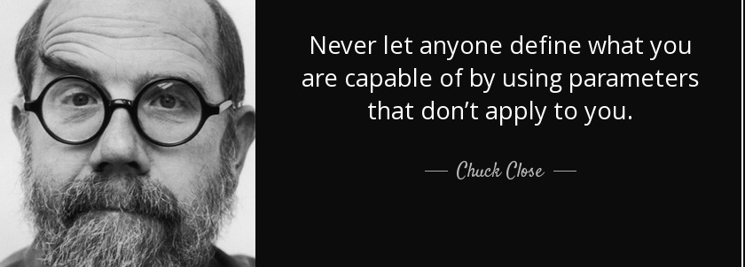
I love some of his thoughts and ideas

Slide 27
I hope by the end of this class you will love Painting too (or at least hate it less ☺)!
PAINTING
ROCKS!!!

